Slide 1


Sybex CCNA 640-802
Chapter 13: Network Address Translation
Instructor & Todd Lammle

Slide 2

Chapter 13 Objectives
The CCNA Topics Covered in this chapter include:
What is NAT
  Static
  Dynamic
  PAT
Configuring NAT
Verifying NAT

Slide 3
What is NAT?
Similar to Classless Inter-Domain Routing (CIDR), the original intention for NAT was to slow the depletion of available IP address space by allowing many private IP addresses to be represented by some smaller number of public IP addresses.

Slide 4
Benefits of NAT
You need to connect to the Internet and your hosts don’t have globally unique IP addresses.
You change to a new ISP that requires you to renumber your network.
You need to merge two intranets with duplicate addresses.

Slide 5
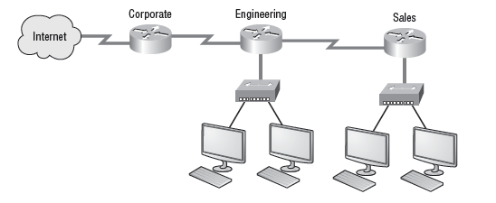
Where NAT is typically configured

Slide 6
Three types of NAT
Static
Dynamic
Overloading

Slide 7
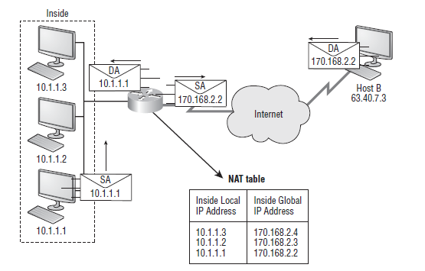
Basic NAT

Slide 8
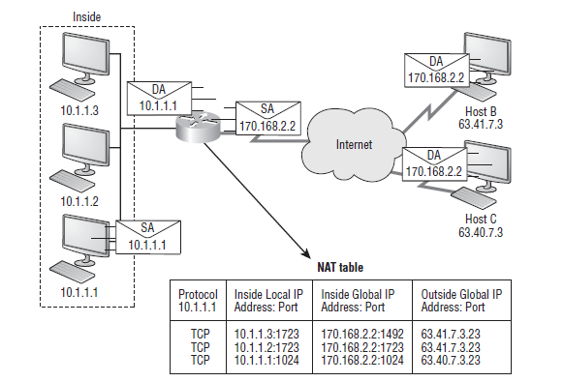
NAT Overloading

Slide 9
Static NAT
Let’s take a look at a simple basic static NAT configuration:
ip nat inside source static 10.1.1.1 170.46.2.2
!
interface Ethernet0
ip address 10.1.1.10 255.255.255.0
ip nat inside
!
interface Serial0
ip address 170.46.2.1 255.255.255.0
ip nat outside
!

Slide 10
Dynamic NAT
Here is a sample output of a dynamic NAT configuration:
ip nat pool todd 170.168.2.2 170.168.2.254
netmask 255.255.255.0
ip nat inside source list 1 pool todd
!
interface Ethernet0
ip address 10.1.1.10 255.255.255.0
ip nat inside
!
interface Serial0
ip address 170.168.2.1 255.255.255.0
ip nat outside
!
access-list 1 permit 10.1.1.0 0.0.0.255
!

Slide 11
PAT
Here is a sample output of a PAT configuration:
ip nat pool globalnet 170.168.2.1 170.168.2.1
netmask 255.255.255.0
ip nat inside source list 1 pool globalnet overload
!
interface Ethernet0/0
ip address 10.1.1.10 255.255.255.0
ip nat inside
!
interface Serial0/0
ip address 170.168.2.1 255.255.255.0
ip nat outside
!
access-list 1 permit 10.1.1.0 0.0.0.255

Slide 12
Testing and Troubleshooting NAT
Router#show ip nat trans
Pro Inside global Inside local Outside local Outside global
--- 192.2.2.1 10.1.1.1 --- ---
--- 192.2.2.2 10.1.1.2 --- ---
Router#sh ip nat trans
Pro Inside global Inside local Outside local Outside global
tcp 170.168.2.1:11003 10.1.1.1:11003 172.40.2.2:23 172.40.2.2:23
tcp 170.168.2.1:1067 10.1.1.1:1067 172.40.2.3:23 172.40.2.3:23
Router#debug ip nat
NAT: s=10.1.1.1->192.168.2.1, d=172.16.2.2 [0]
NAT: s=172.16.2.2, d=192.168.2.1->10.1.1.1 [0]
NAT: s=10.1.1.1->192.168.2.1, d=172.16.2.2 [1]
NAT: s=10.1.1.1->192.168.2.1, d=172.16.2.2 [2]
NAT: s=10.1.1.1->192.168.2.1, d=172.16.2.2 [3]
NAT*: s=172.16.2.2, d=192.168.2.1->10.1.1.1 [1]

Slide 13
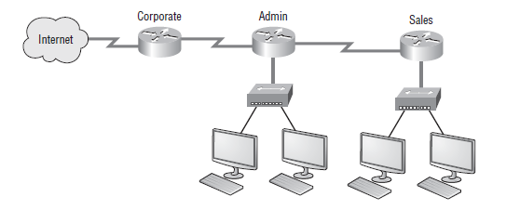
NAT Example

Slide 14
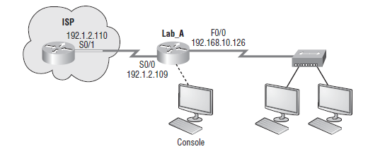

NAT Lab example 2

Slide 15
Summary
  Summary
  Open your books and go through all the written labs and the review questions.
  Review the answers in class.

